Slide 1
Course Code: CSC211A Course Title: Formal Languages and Automata Theory
Lecture 1:Introduction
Course Leader:
Prakash P
prakash.cs.et@msruas.ac.in

Slide 2
Session Objectives
At the end of this session, student will be able to
Explain languages and strings
Discuss operations on languages
Describe Chomsky Hierarchy

Slide 3
Session Topics
Alphabets
Strings
Languages
String Operations
Operations on Languages

Slide 4
Languages
A language is a set of strings
String: A sequence of letters
Examples: “cat”, “dog”, “house”, …
Defined over an alphabet:

Slide 5
Alphabets and Strings
Small alphabets:
Strings

Slide 6
String Operations
Concatenation

Slide 7
String Operations
Reverse

Slide 8
String Length
Length:
Examples:

Slide 9
Recursive Definition of Length
For any letter:
For any string :
Example:

Slide 10
Length of Concatenation
Example:

Slide 11
Proof of Concatenation Length
Claim:
Proof: By induction on the length
Induction basis:
From definition of length:

Slide 12
Proof of Concatenation Length
Inductive hypothesis:
for
Inductive step: we will prove
for

Slide 13
Inductive Step
Write , where
From definition of length:
From inductive hypothesis:
Thus:

Slide 14
Empty String
A string with no letters:
Observations:

Slide 15
Substring
Substring of string:
a subsequence of consecutive characters
String Substring

Slide 16
Prefix and Suffix
Prefixes Suffixes
prefix
suffix

Slide 17
Another Operation
Example:
Definition:

Slide 18
The * Operation
: the set of all possible strings from alphabet

Slide 19
The + Operation
: the set of all possible strings from
alphabet except

Slide 20
Language
A language is any subset of
Example:
Languages:

Slide 21
Another Example
An infinite language

Slide 22
Operations on Languages
The usual set operations
Complement:

Slide 23
Reverse
Definition:
Examples:

Slide 24
Concatenation
Definition:
Example:

Slide 25
Another Operation
Definition:
Special case:

Slide 26
More Examples

Slide 27
Star-Closure (Kleene *)
Definition:
Example:

Slide 28
Positive Closure
Definition:

Slide 29
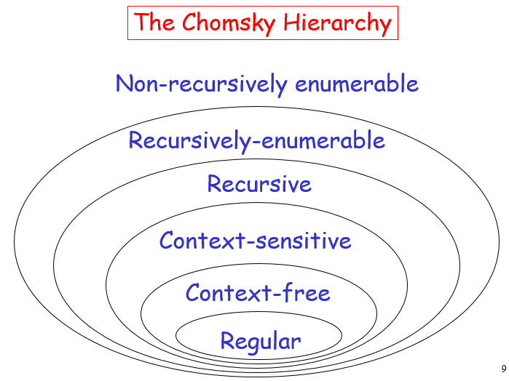
Chomsky Hierarchy

Slide 30
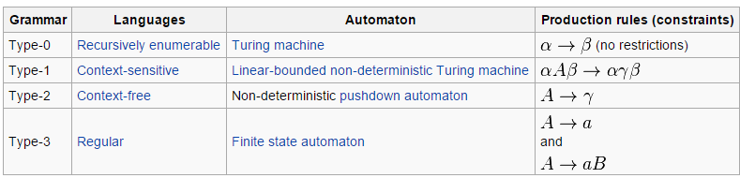
Chomsky Hierarchy

Slide 31
Summary
A language is a set of strings
Substring of string is a subsequence of consecutive characters
A string with no letters is an empty string

